Slide 1
SISTEMAS OPERATIVOS
SO
E – M 2019

Slide 2
Memory Management
Main Memory (cont.)

Slide 3
Contiguous Memory Allocation
Main memory must support both OS and user processes
Contiguous memory allocation is one early method
Earlier, main memory usually divided into two partitions:
Resident operating system, usually held in low memory with interrupt vector
User processes then held in high memory
Each process is contained in a single contiguous section of memory
Peripheral controllers, mapped into the very last high memory

Slide 4
Memory Protection - 1
Relocation (Base) registers is used to protect user processes from each other, and from changing operating-system code and data
Base (relocation) register contains value of smallest physical address
Limit register contains range of logical addresses – < limit register
MMU maps logical address dynamically

Slide 5
Memory Protection - 2

Slide 6
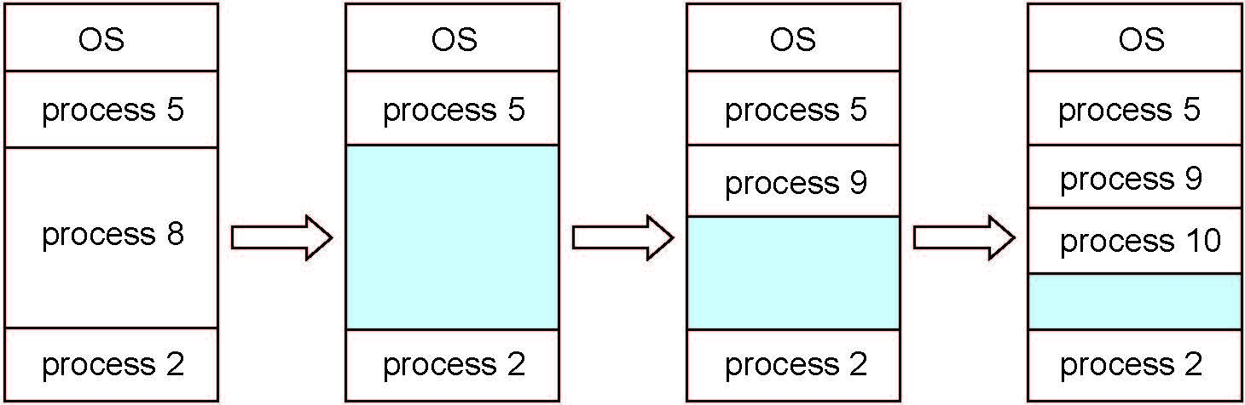
Memory allocation
Multiple-partition allocation, one partition – one process inside
Multiprogramming degree limited by number of partitions: fixed-sized partition
Variable-partition sizes for efficiency (sized to a given process’ needs)
Hole – block of available memory; holes of various size are scattered throughout memory
When a process arrives, it is allocated memory from a hole large enough to accommodate it
Process exiting frees its partition, adjacent free partitions combined
Operating system maintains information table about: a) allocated partitions b) free partitions (holes)

Slide 7
Dynamic Storage-Allocation Problem
How to satisfy a request of size n from a list of free holes?
First-fit: Allocate the first hole that is big enough
Best-fit: Allocate the smallest hole that is big enough; must search entire list, unless ordered by size
Produces the smallest leftover hole
Worst-fit: Allocate the largest hole; must also search entire list
Produces the largest leftover hole
First-fit and best-fit better than worst-fit in terms of speed and storage utilization

Slide 8
Memory Fragmentation - 1
External Fragmentation – total memory space exists to satisfy a request, but it is not contiguous
Internal Fragmentation – allocated memory (fixed-sized blocks) may be slightly larger than requested memory; this size difference is memory internal to a partition, but not being used
First fit analysis reveals that given N blocks allocated, 0.5 N blocks lost to fragmentation
1/3 may be unusable -> 50-percent rule

Slide 9
Memory Fragmentation - 2
Reduce external fragmentation by compaction
Shuffle memory contents to place all free memory together in one large block
Compaction is possible only if relocation is dynamic, and is done at execution time
I/O problem
Latch job in memory while it is involved in I/O
Do I/O only into OS buffers
Now consider that backing store has same fragmentation problems

Slide 10
Segmentation
Hardware point of view: partitions and blocks
Segmentation (hardware)
Memory mechanism that supports programmer’s view of memory
Solution for external fragmentation
A program is a collection of segments
A segment is a logical unit such as:
main program
procedure, function, method
local variable, global variable
common block
array, object, heap
stack
symbols table

Slide 11
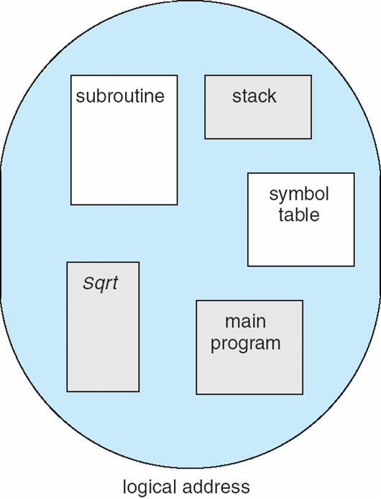
Programmer’s View of a Program

Slide 12
Logical View of Segmentation
1
1
4
2
3
4
2
3
user space
physical memory space

Slide 13
Segmentation Architecture
Logical address consists of a two tuple:
<segment-number s, offset d>,
Segment table – maps two-dimensional physical addresses; each table entry has:
base – contains the starting physical address where the segments reside in memory
limit – specifies the length of the segment
Segment-table base register (STBR) points to the segment table’s location in memory
Segment-table length register (STLR) indicates number of segments used by a program;
segment number s is legal if s < STLR

Slide 14
Segmentation Example

Slide 15
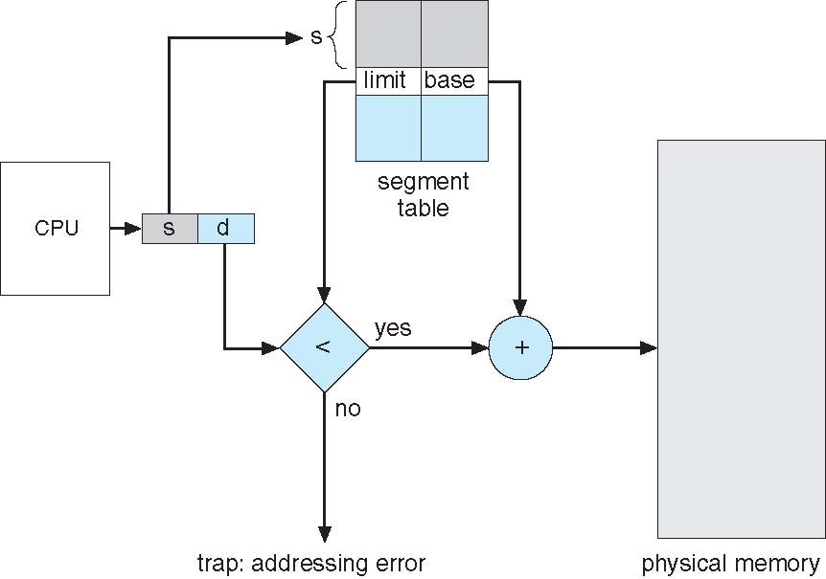
Segmentation Hardware Architecture

Slide 16
References
Presentación de Ramon Ríos.
Capítulos: Operating System Concepts; Silberschatz, Galvin, Gagne.
30-abr-2019

